Slide 1
Presentation for Igrene Shareholders
Grant Strem, M.Sc., P.Geol.
Chairman & CEO
Proton Technologies Canada Inc.
On Behalf of All Natural Swedish Oil AB (ANSO)

Slide 2
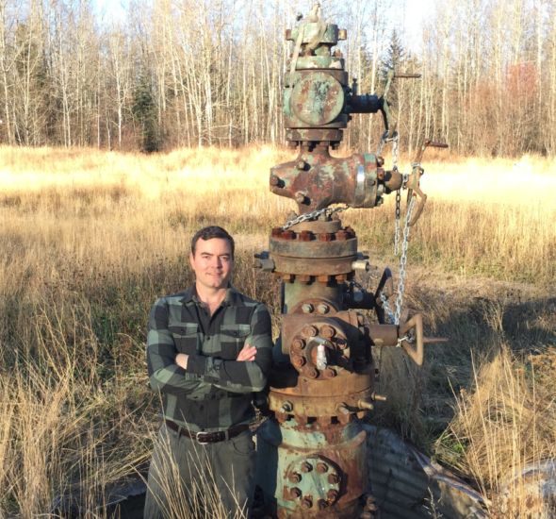
Earth’s largest known oil deposit is in Canada.
Below it, gas and oil were discovered in features
that Iconoil believes are similar to the Siljan Ring(s).

Slide 3
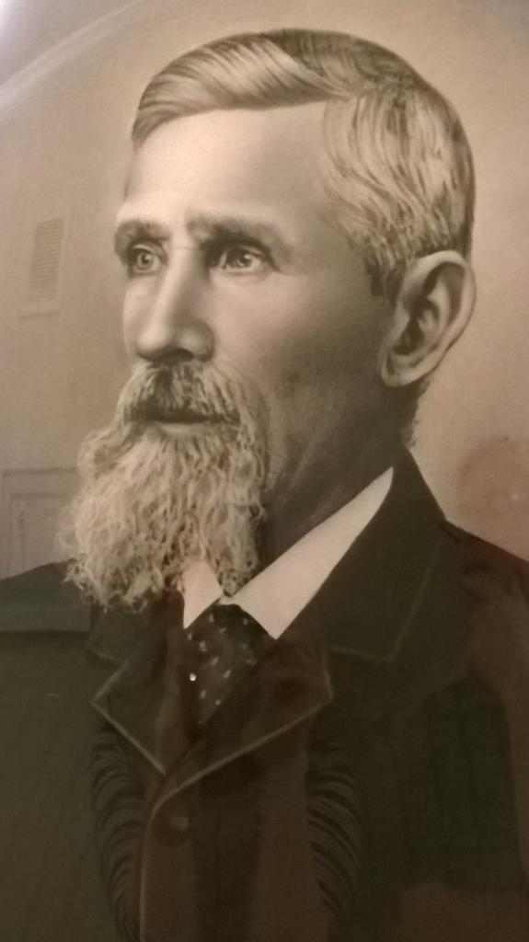
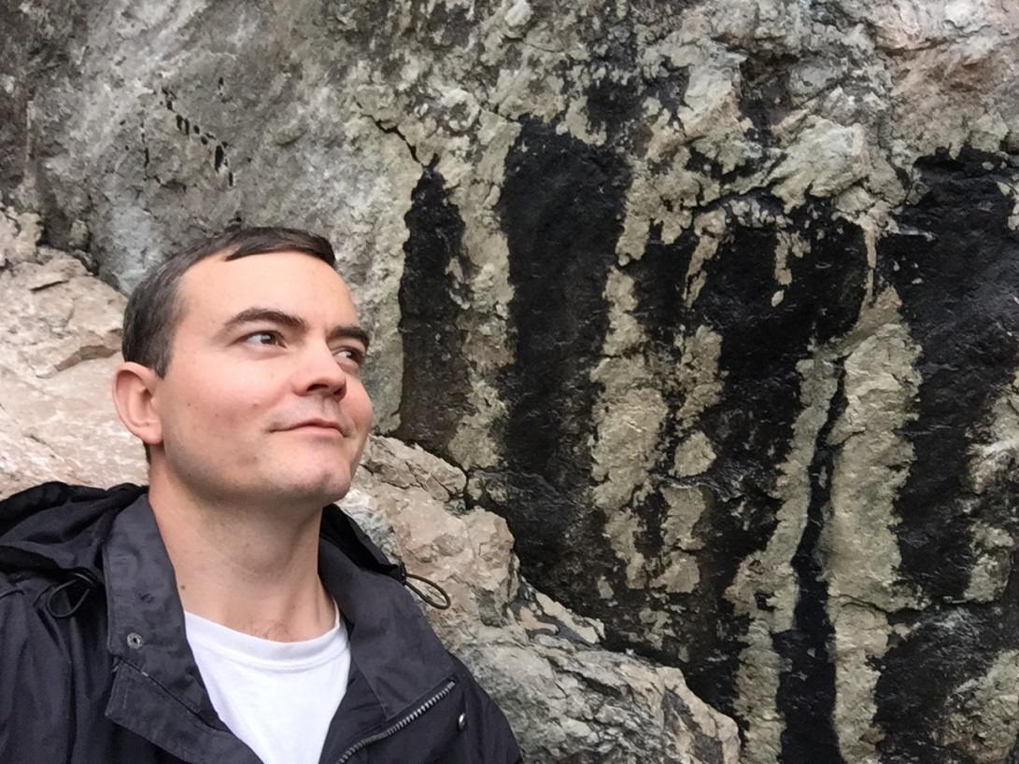
Son of Sweden Returns
Peter Strem – my Great Great Grandfather
Born in Sweden 1833
Grant Strem – First Arrived in Sweden 2015
Canadian Oil and Gas Explorationist
Very Excited

Slide 4
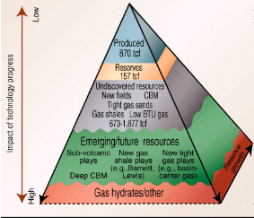
The Resource Pyramid: Fat Bottom
Impact of Technology Progress
Source: Oil & Gas Journal

Slide 5
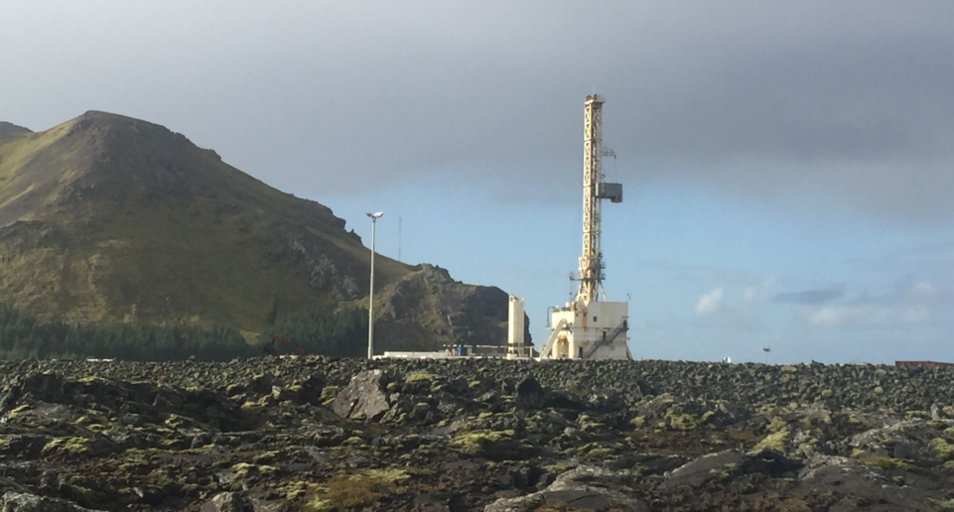
Indigenous European Gas Supply is Declining
Since 1970 Europe has gone from supplying 100% of it’s own gas to only 50%
Onshore Swedish hydrogen can reverse this trend

Slide 6
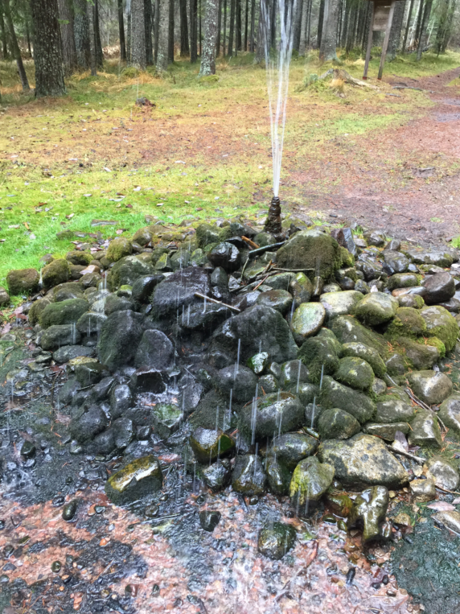
Local Lore
Sign at SpringKallen mention an 18th century oil discovery at Odmondsberg
Town of Oljonsby (Oil Village) and Gasen (Gas Lake) point
Three hundred years ago, Carl von Linne recognized oil
while classifying Swedish flora.
Recent local stories support the historical events:
• limestone quarries leak oil and gas through fractures
• intended water wells abandoned because
they produce oil or gas instead of water
• several locals claim they can ignite their tap water
LOCAL LORE
Stories of Gas & Oil in the Water
Have Been Around For Centuries
In fact, it is said that one resident of Mora heated
his buildings using a continuous dry gas flame
from an intended water well!
Opposite: Bubbles can be seen rising through
the water in many of the area’s lakes. Significant
gas seepage prevents them from icing over in
the winter. In some small lakes, boats allegedly
float much lower because of the volume of
methane bubbles in the water column.

Slide 7
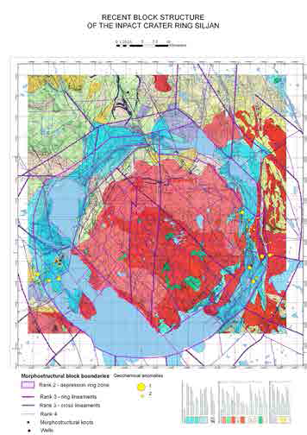
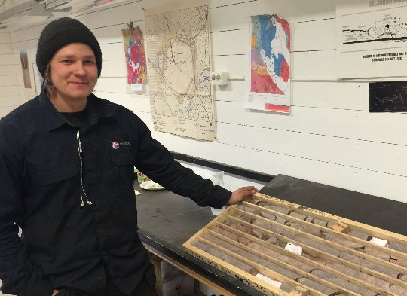
Interesting Resource

Slide 8
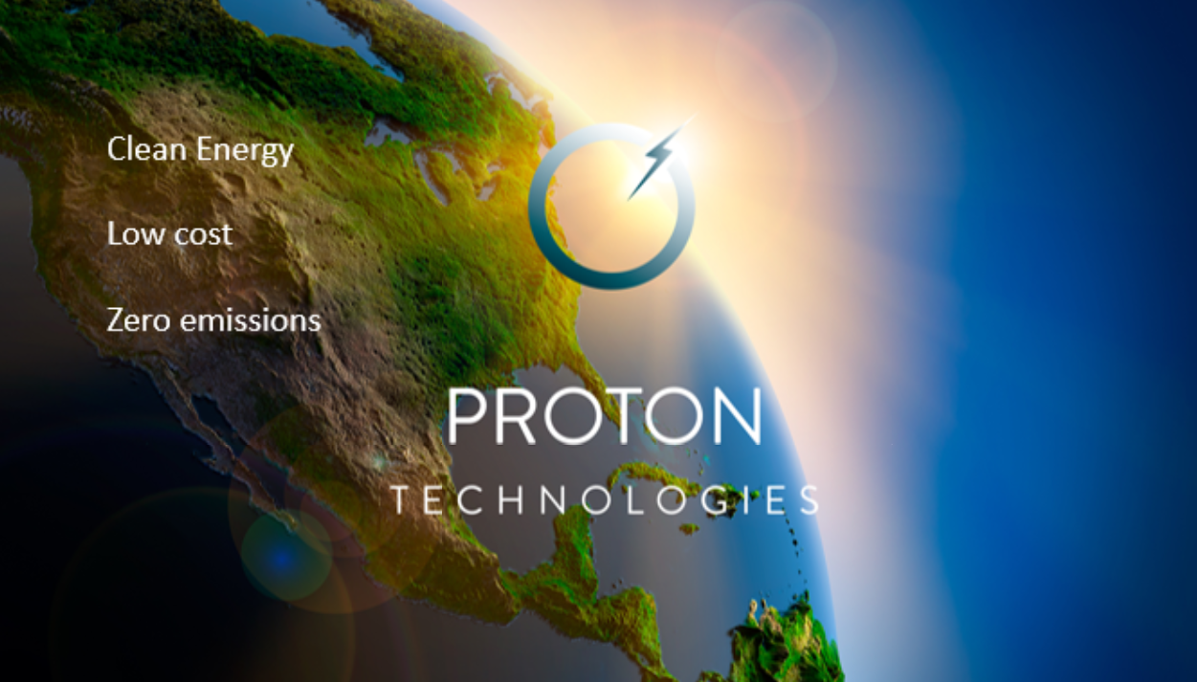

Slide 13
